Slide 1
A REVIEW-BASED RESTAURANT RECOMMENDATION SYSTEM
DONE BY:
CB.EN.U4CSE19105 –Athmakuri V V L N Balaramacharyulu
CB.EN.U4CSE19137 -P.S.V.Akash
CB.EN.U4CSE19154 -T.sai jayanth
CB.EN.U4CSE19165 – P. Prem sai

Slide 2
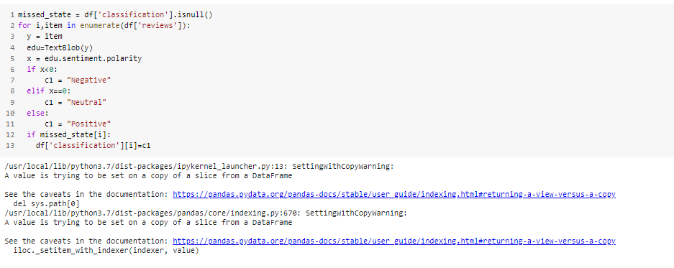
SENTIMENT ANALYSIS
Sentiment analysis is the process of detecting positive or negative sentiment in text.
It's often used by businesses to detect sentiment in social data. understanding of their reviews through the application of sentiment analysis.

Slide 3
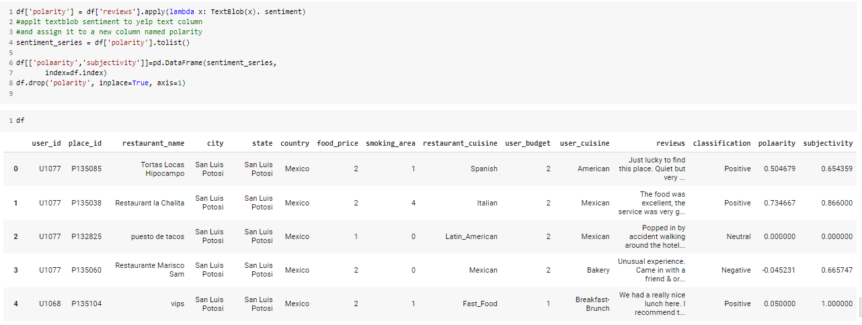

Slide 4
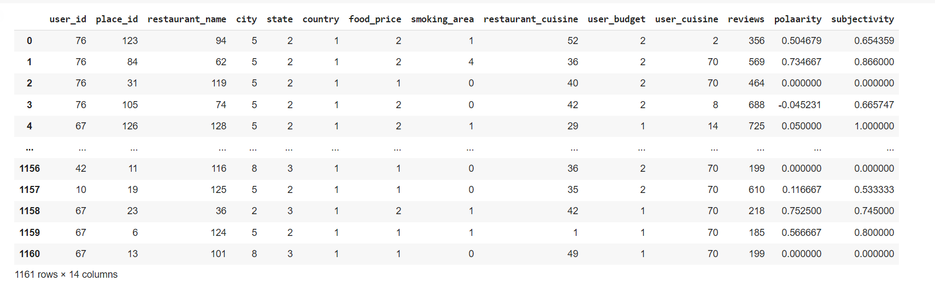
LABEL ENCODING

Slide 5
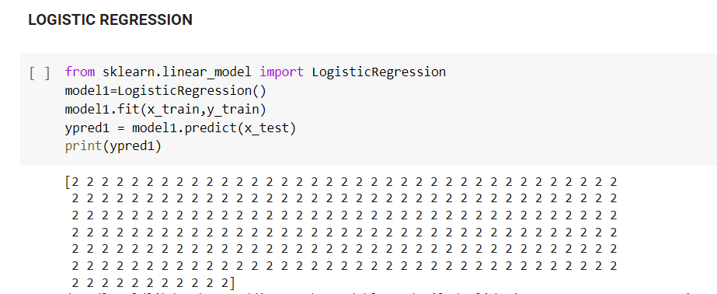

Slide 6
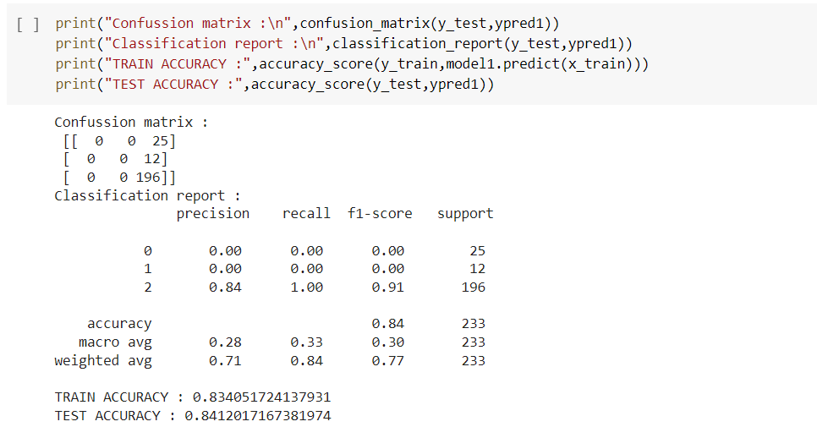

Slide 7
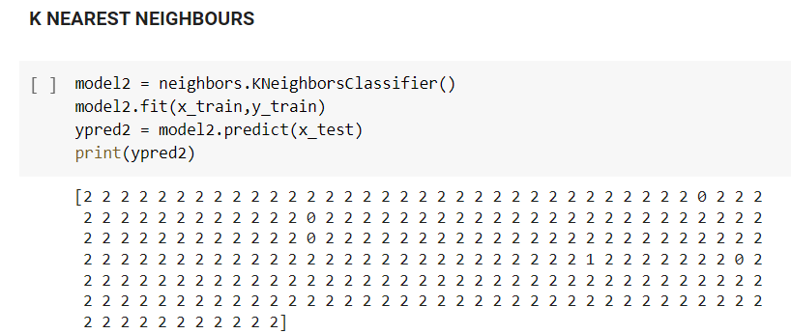

Slide 8
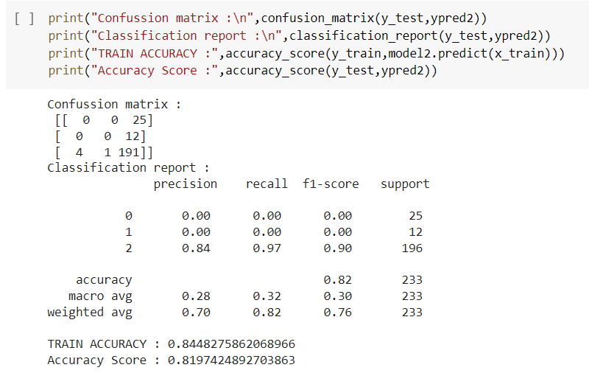

Slide 9
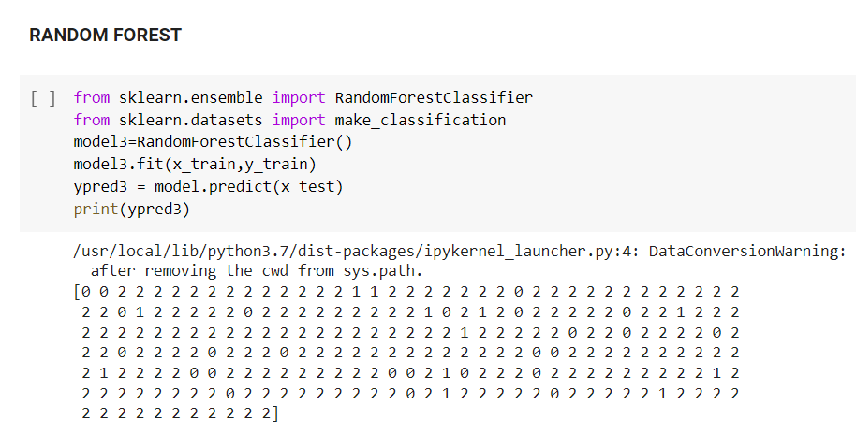

Slide 10
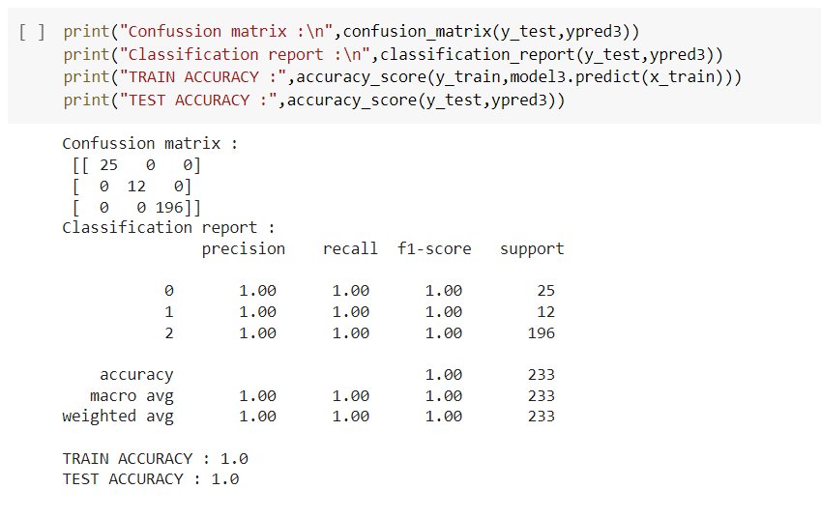

Slide 11
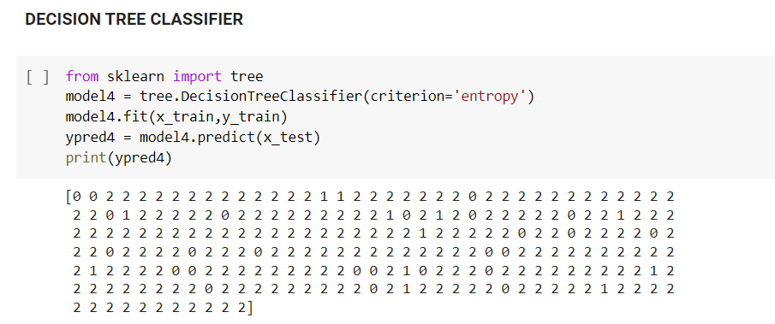

Slide 12
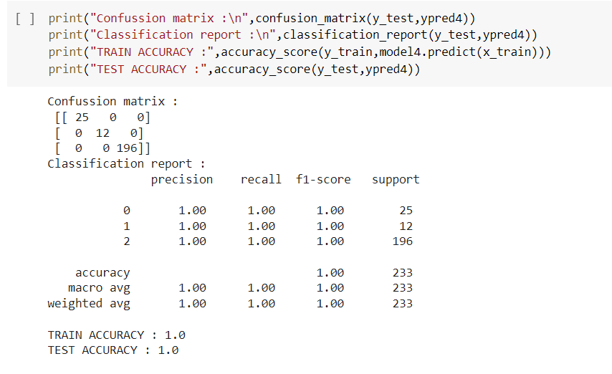

Slide 13
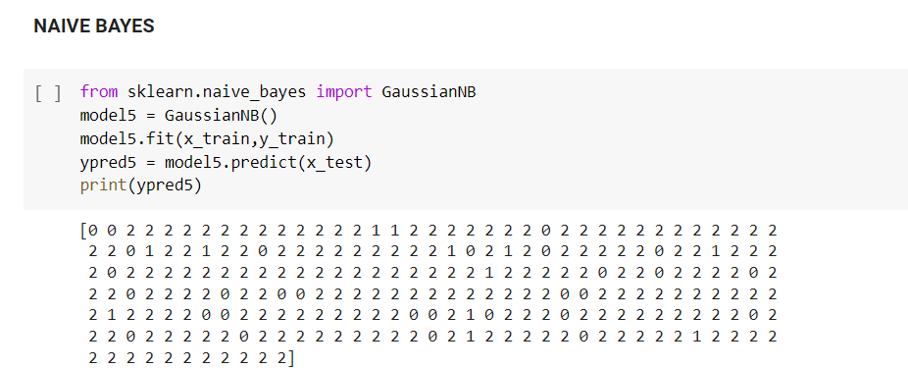

Slide 14
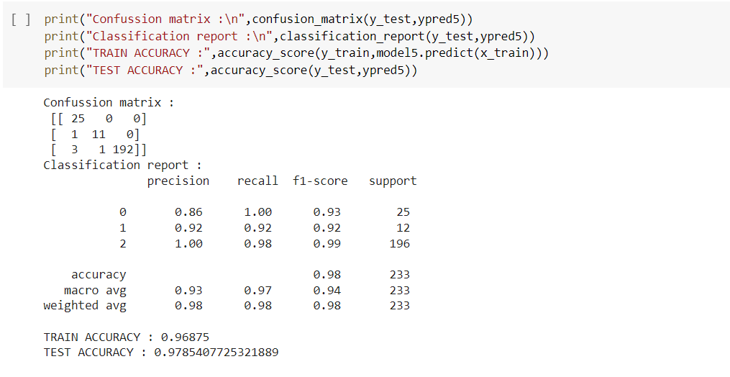

Slide 15
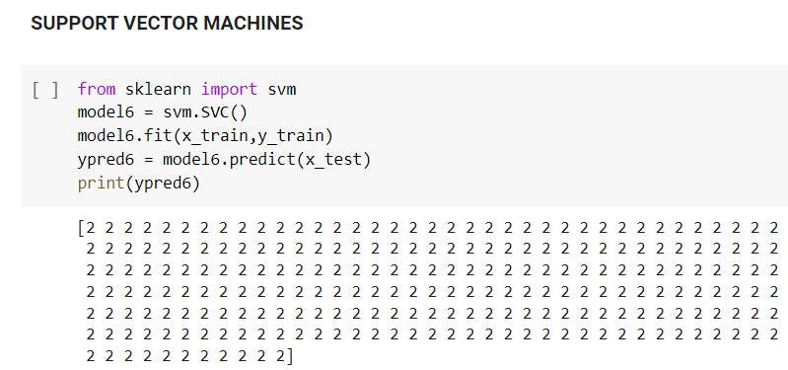

Slide 16
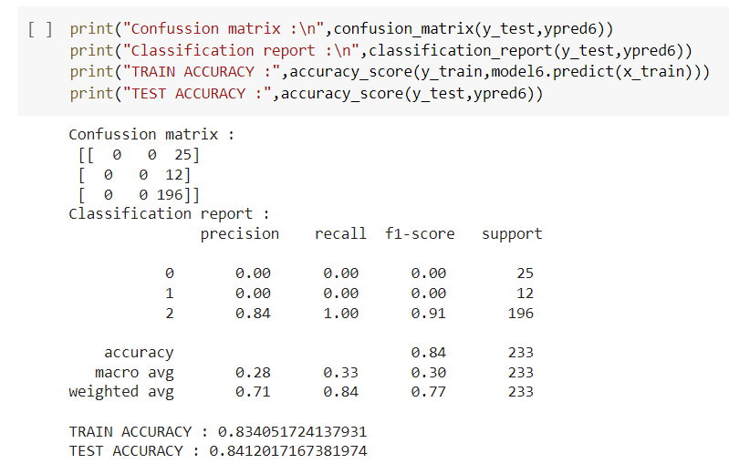

Slide 17
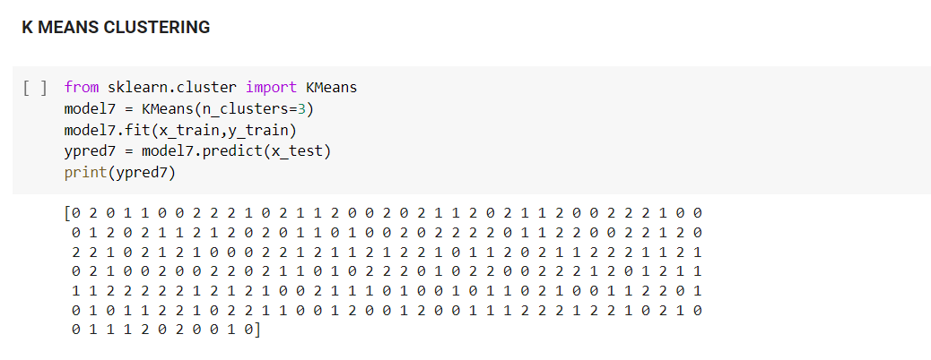

Slide 18
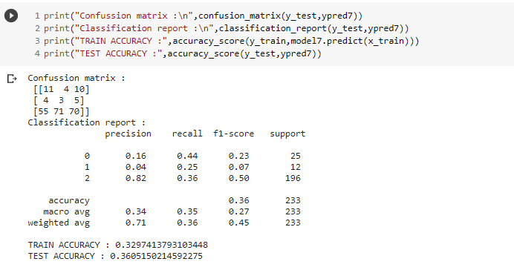

Slide 19
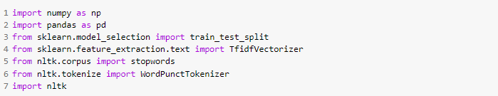
COLLABORATIVE FILTERING

Slide 20
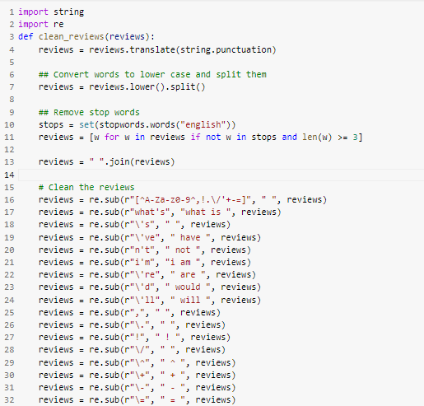
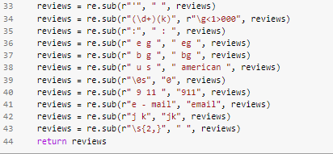

Slide 21
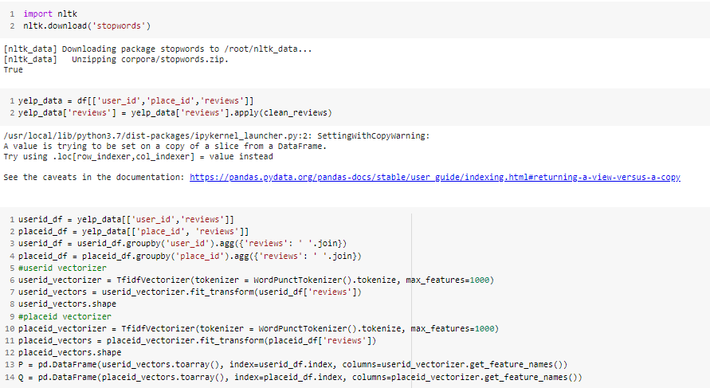

Slide 22
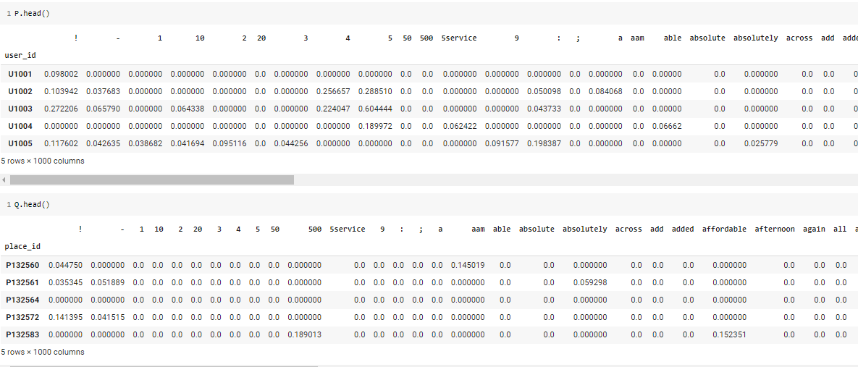

Slide 23
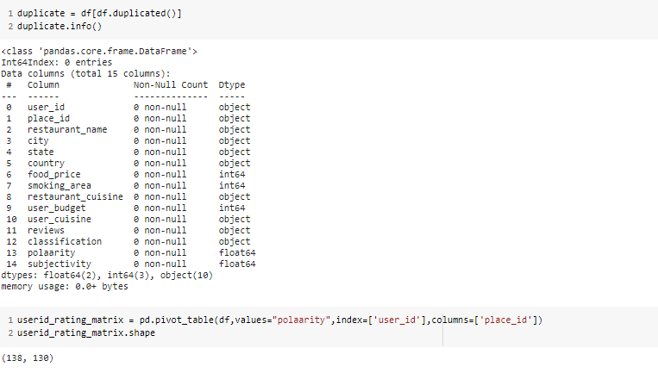

Slide 24
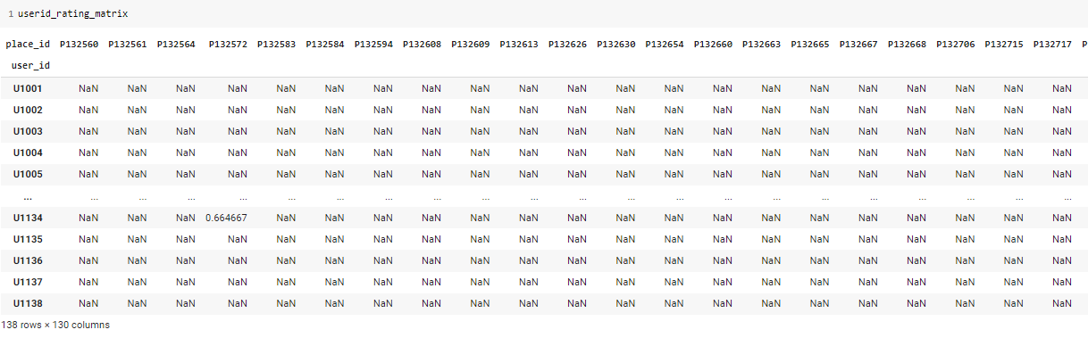

Slide 25
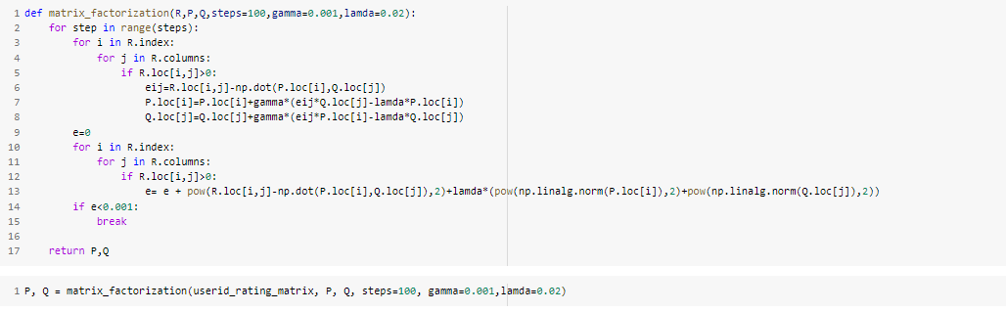

Slide 26
